Slide 1
IMPLEMENTATION ACTIONS
ACTION B.5 - Progress
Pilot Area 1 (Milan): system implementation
Paola Coppi, Simone Radaelli

Slide 2
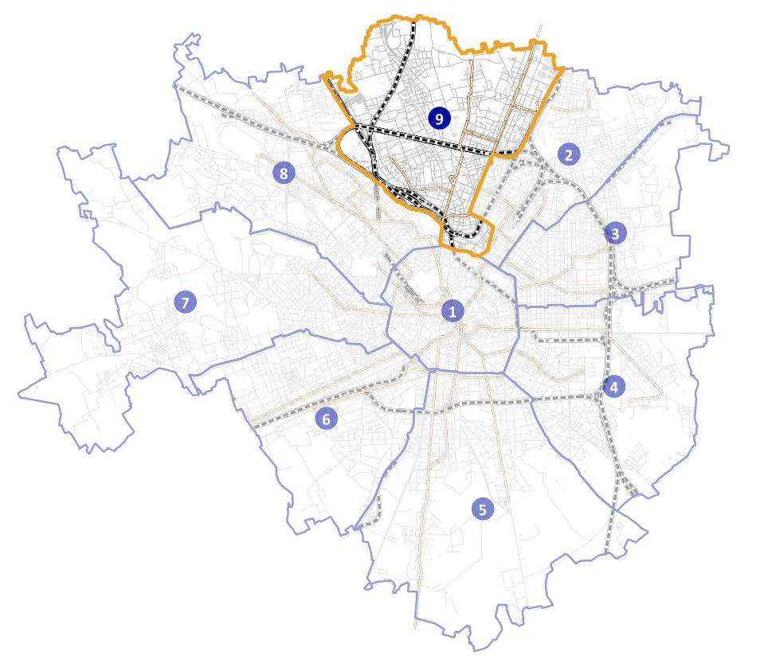
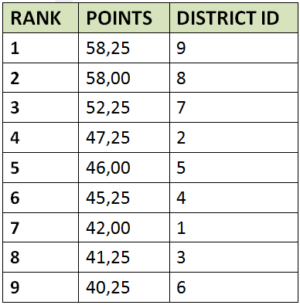
PILOT AREA LOCATION FOR URBAN CONTEXT (MILAN)
- Ranking list -

Slide 3
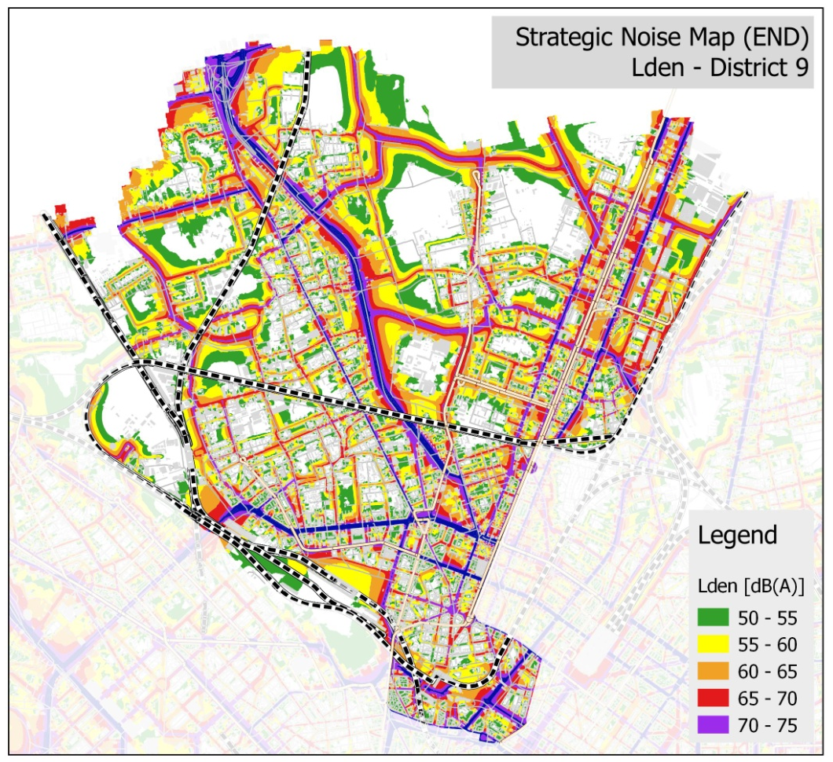
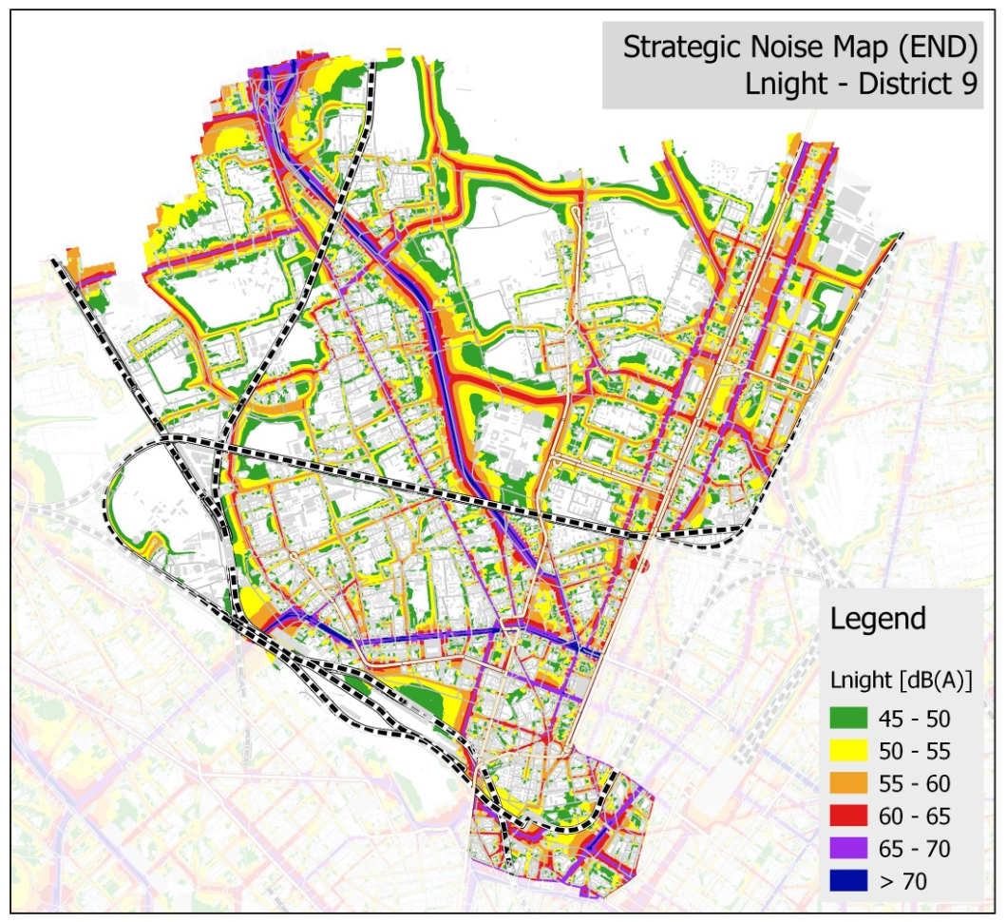
PILOT AREA LOCATION FOR URBAN CONTEXT (MILAN)
- District 9 -

Slide 4
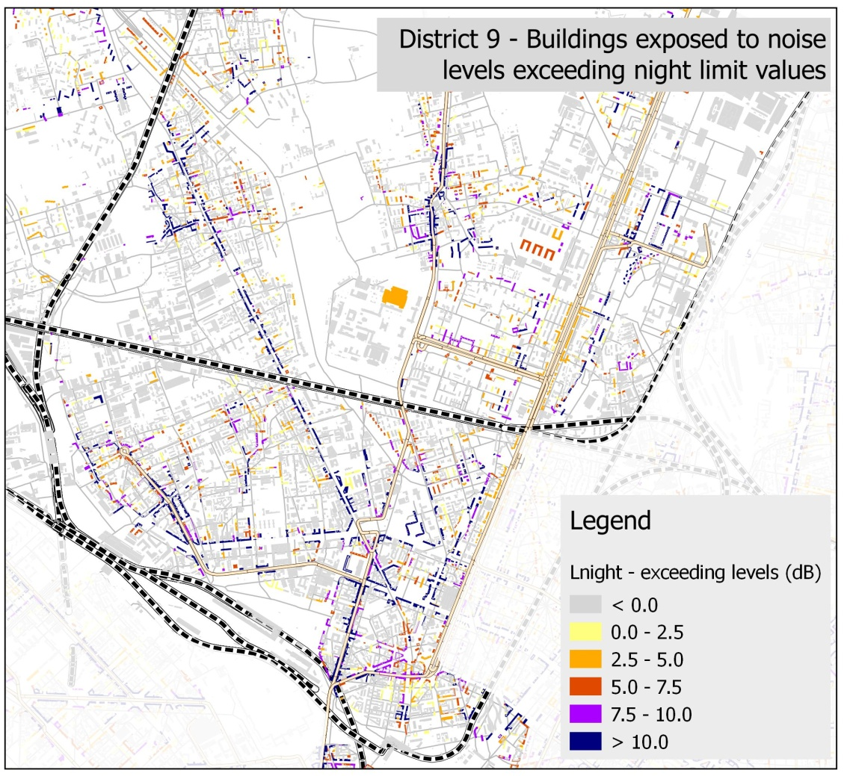
PILOT AREA LOCATION FOR URBAN CONTEXT (MILAN)
- District 9 -

Slide 5
INTRODUCTION – Action B5
Action B5 concern the implementation of the DYNAMAP system in the Pilot Area 1 and required the following task:
B5.1 – basic noise maps calculation
B5.2 – system acquisition and installation
B5.3 – system start-up and maintenance
B5.4 – technical manual and user guide preparation

Slide 6
INTRODUCTION – Task B5.1
As for action B5.1, three main activities were done in order to calculate noise maps:
The collection and elaboration of data for acoustic model
The software’s choice for basic maps calculation
The calculation of basic noise maps

Slide 7
DATABASE DEFINITION
Data collection and elaboration for geographical data regarding:
Buildings (residential /non residential, height, population)
Road network (traffic volume, road geometry, road classification, road surface type)
Public transport network (bus)
Green areas
Sound barriers

Slide 8
DATABASE DEFINITION
Residential buildings

Slide 9
DATABASE DEFINITION
Residential buildings
Non- Residential buildings

Slide 10
DATABASE DEFINITION
Residential buildings
Non residential buildings
Road network

Slide 11
DATABASE DEFINITION
Residential buildings
Non residential buildings
Road networks
Public transport network (bus)

Slide 12
DATABASE DEFINITION
Residential buildings
Non residential buildings
Road network
Public transport network
Green Areas

Slide 13
TASK B5.1 Noise maps calculation
Task B5.1 main objective is to create six basic noise maps for the road types defined by Action B1.
As presented in action B1 urban roads of Milan Municipality are divided into six categories in order to describe their caracteristics based on acoustic and non acoustic parameters.

Slide 14
TASK B5.1 Noise maps calculation
MAIN CALCULATION PARAMETERS
Parameter | Value
Max research radius | 800 m
Number of reflections | 1
Default ground absorption | 0,0
Receiver spacing | 10 m x 10 m
Receiver height | 4,0 m
Traffic flow conditions | Continuous
Traffic speed | According to speed limits

Slide 15
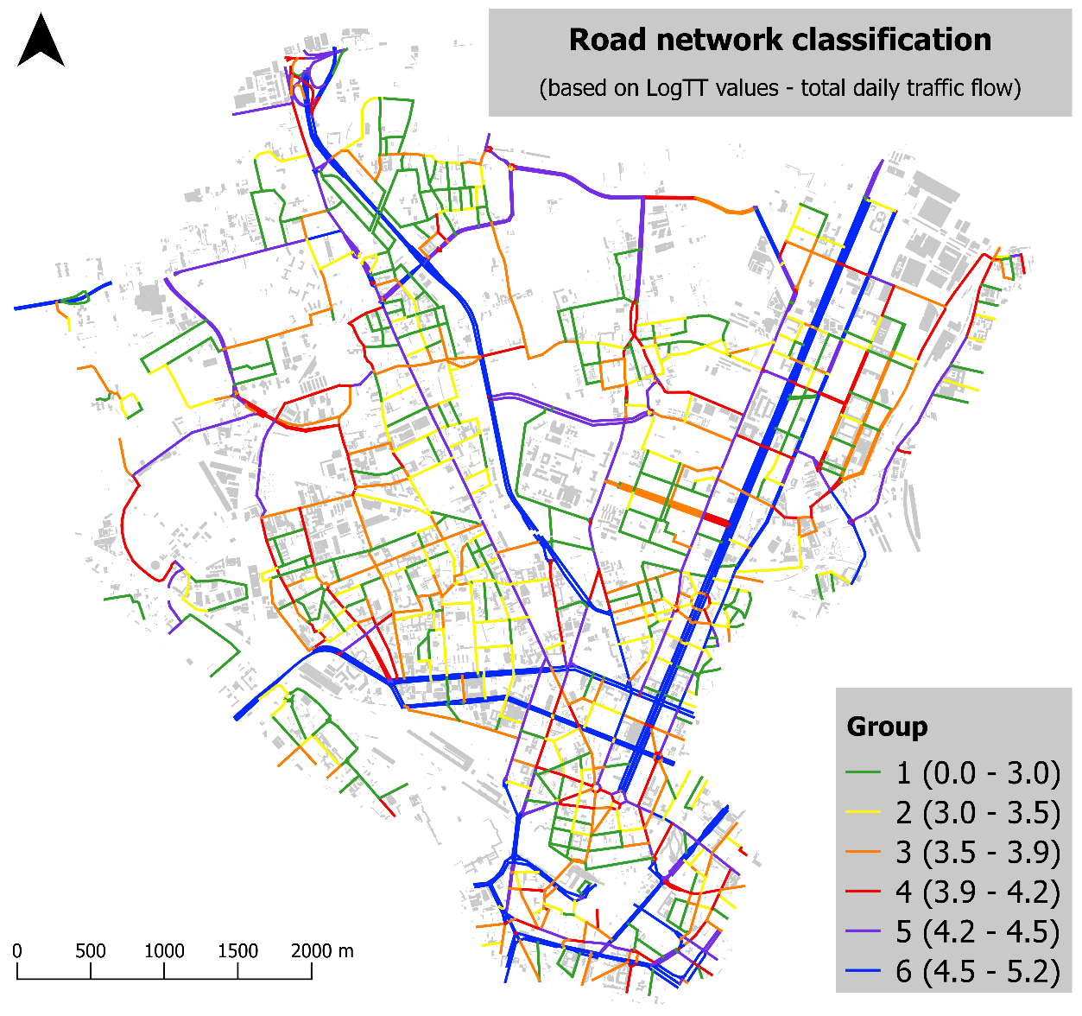
Notes:
In this slide the division based on the non acoustic parameter in six categories is presented for Milan Pilot area. As you can see noise levels are getting higher from the first to the last groups of roads

Slide 16
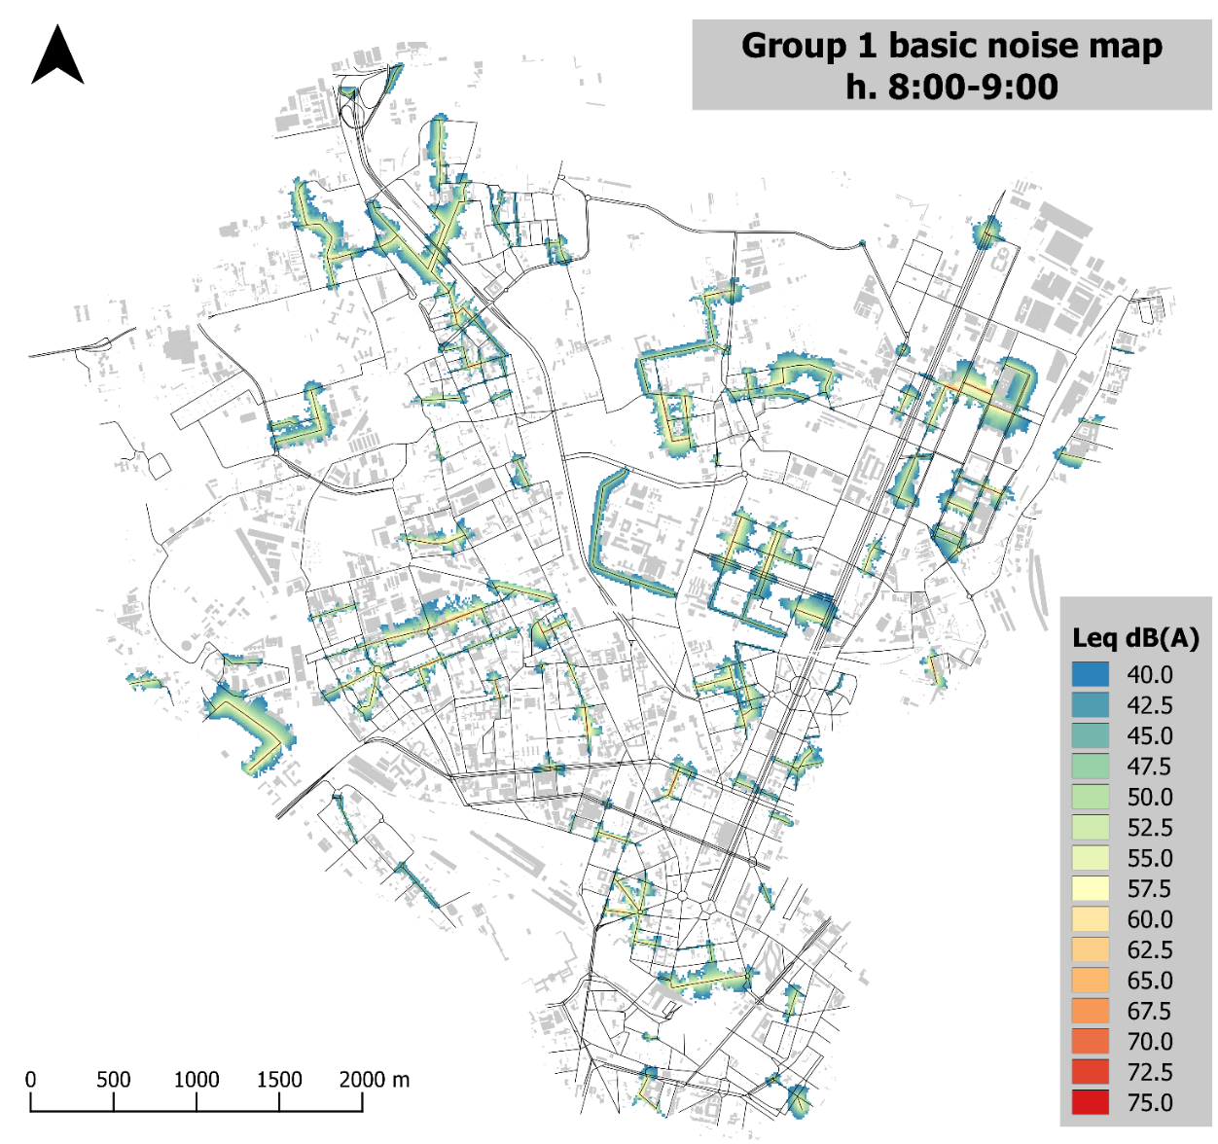
Notes:
Here and in the next slides you find the basic noise maps calculated for the six group of roads

Slide 17
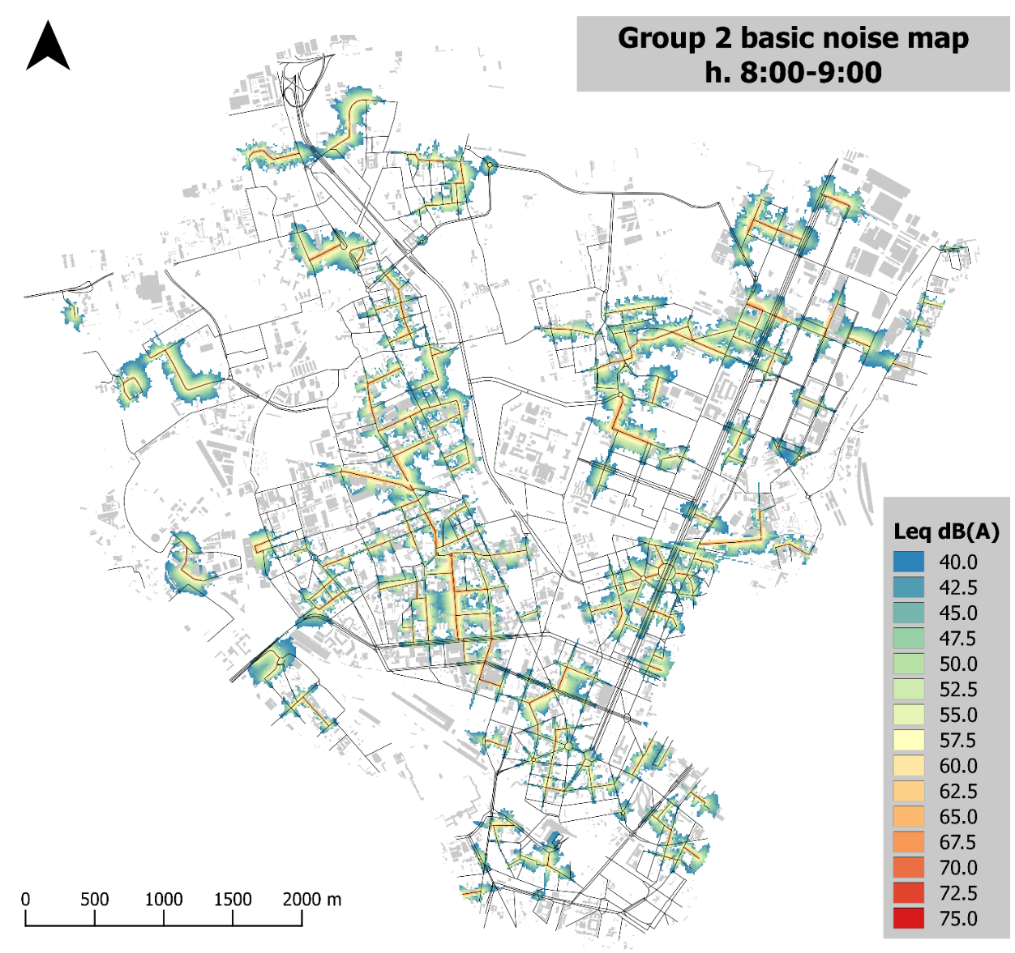

Slide 18
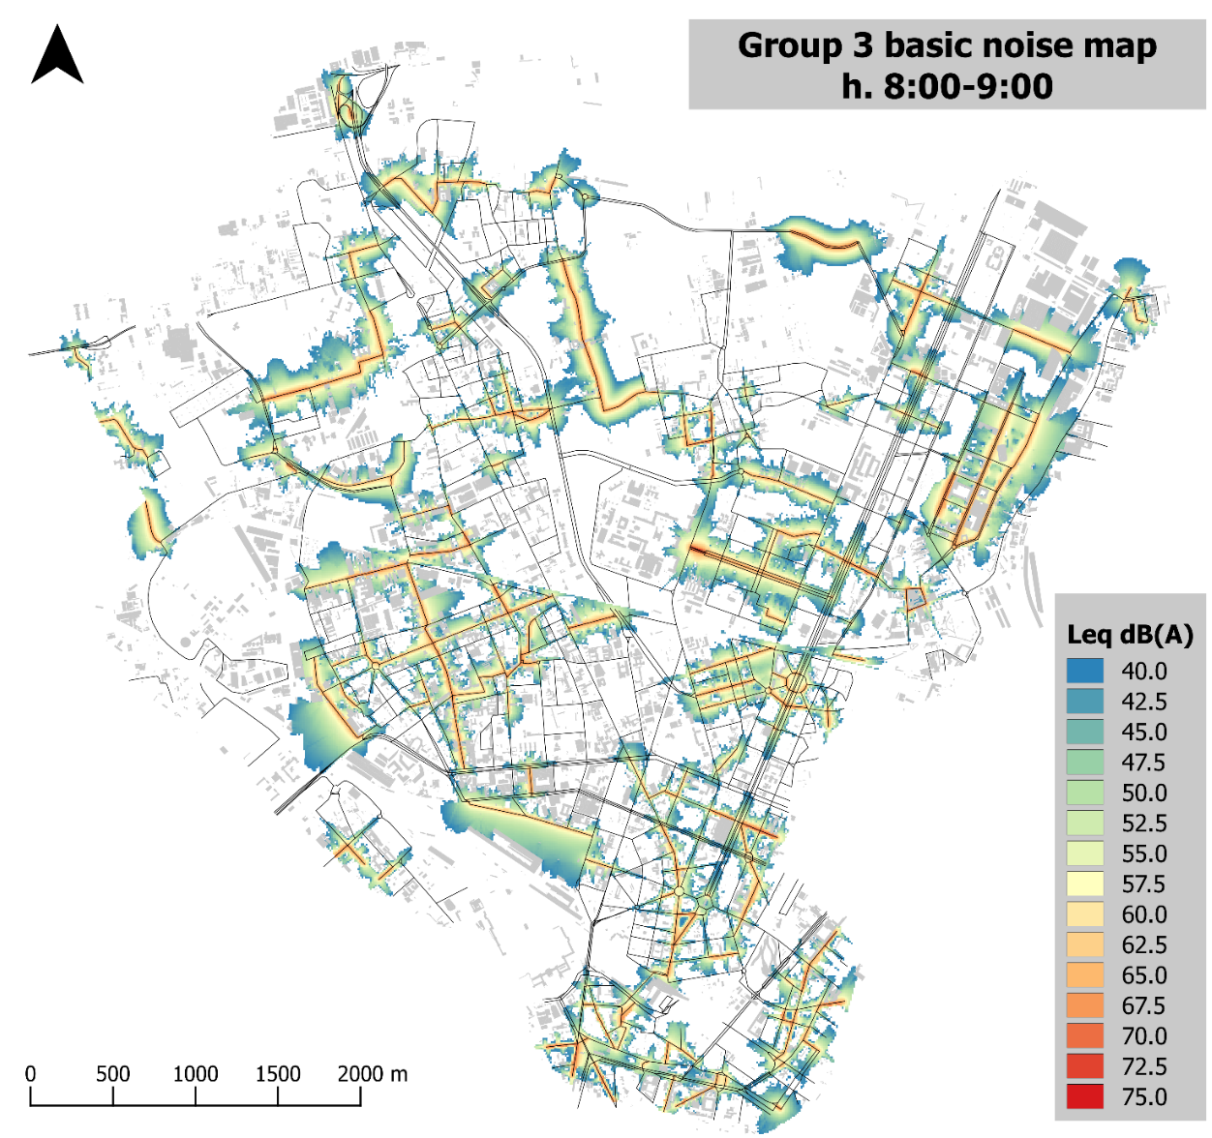

Slide 19
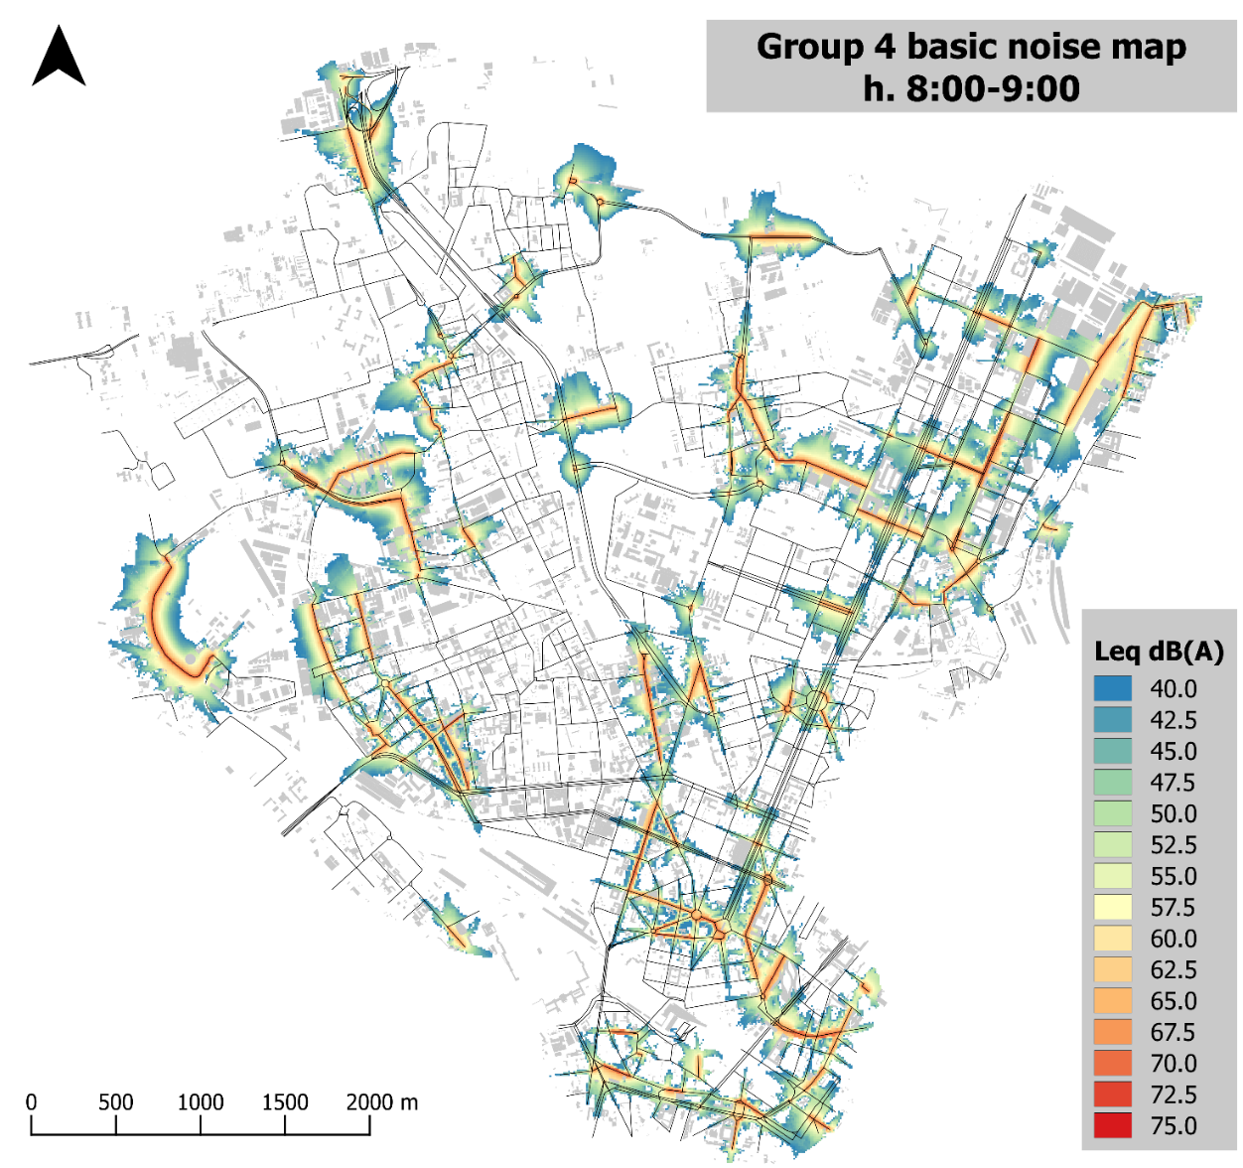

Slide 20
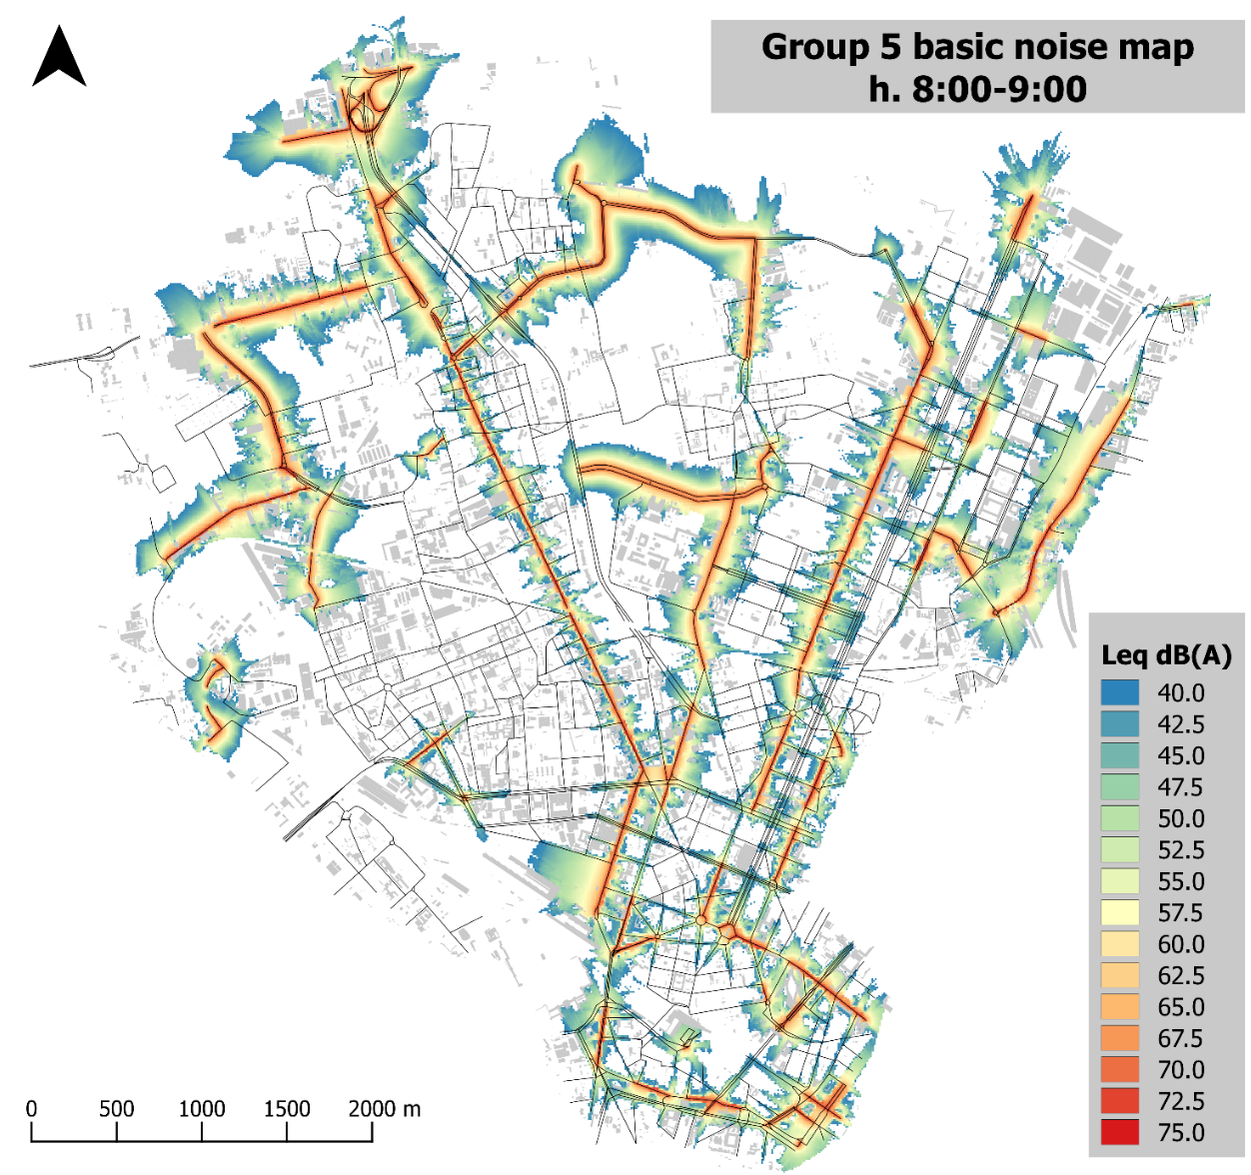

Slide 21
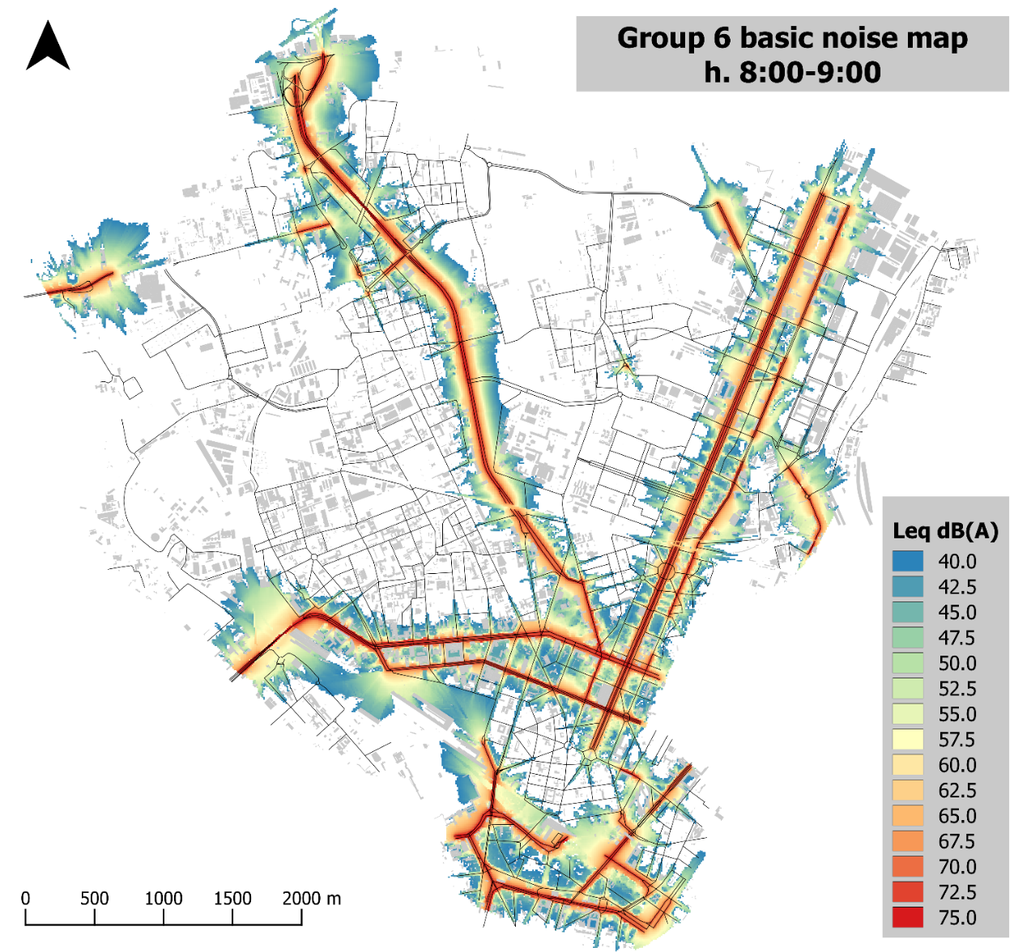

Slide 22
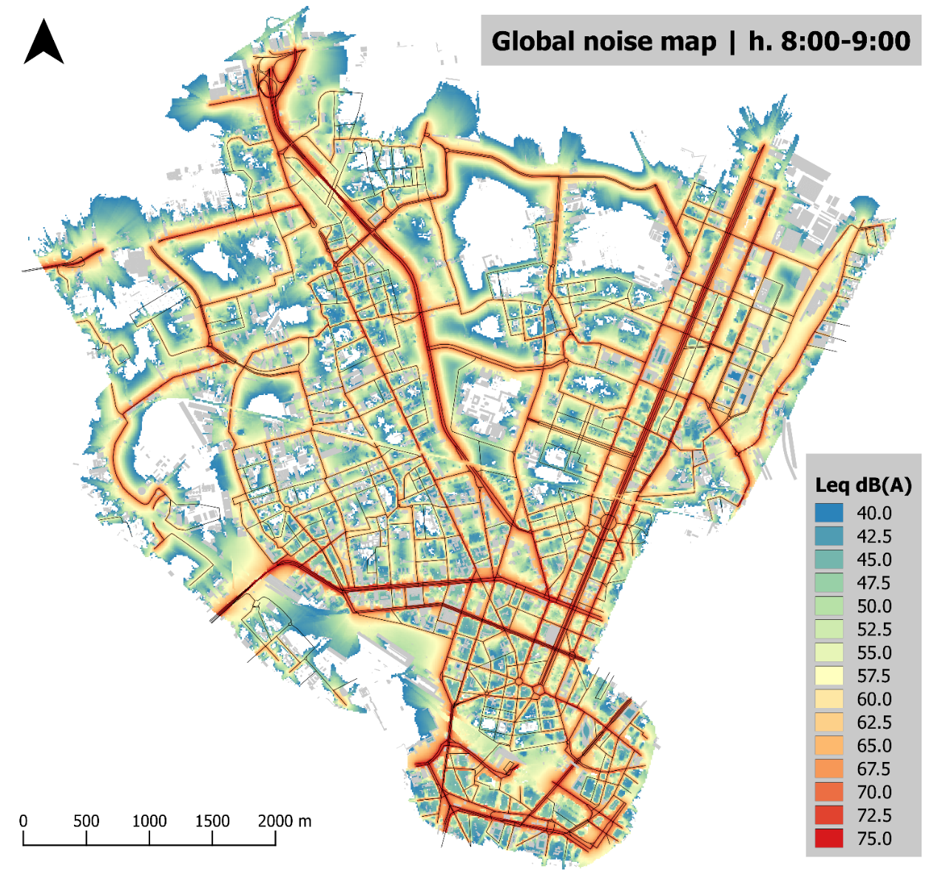
Notes:
This slide represent instead the global noise map containing data from all the six groups.

Slide 23
TASK B5.1 Noise maps calculation
EVALUATION OF INFLUENCE OF TRAFFIC FLOW CONDITIONS
Simulation of congested traffic scenario:
Road segments characterized by traffic flow/capacity ratio > 1.0
Traffic flow condition = “interrupted”
Road traffic speed = 30 km/h

Slide 24
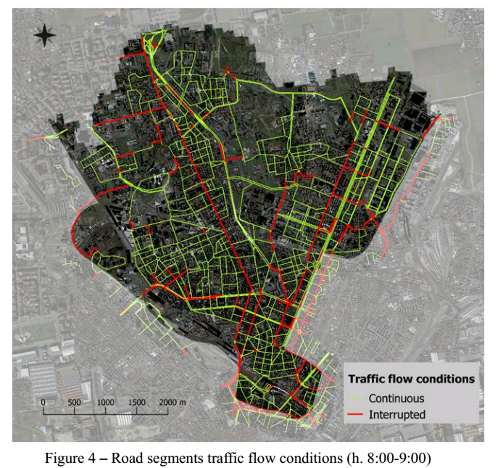

Slide 25
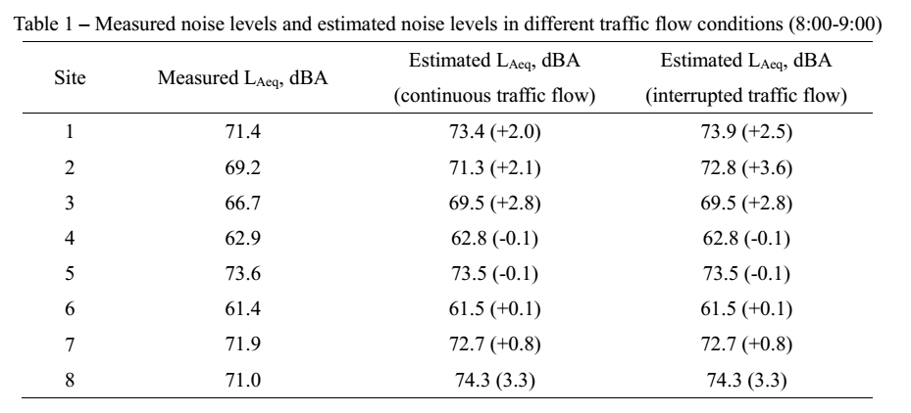

Slide 26
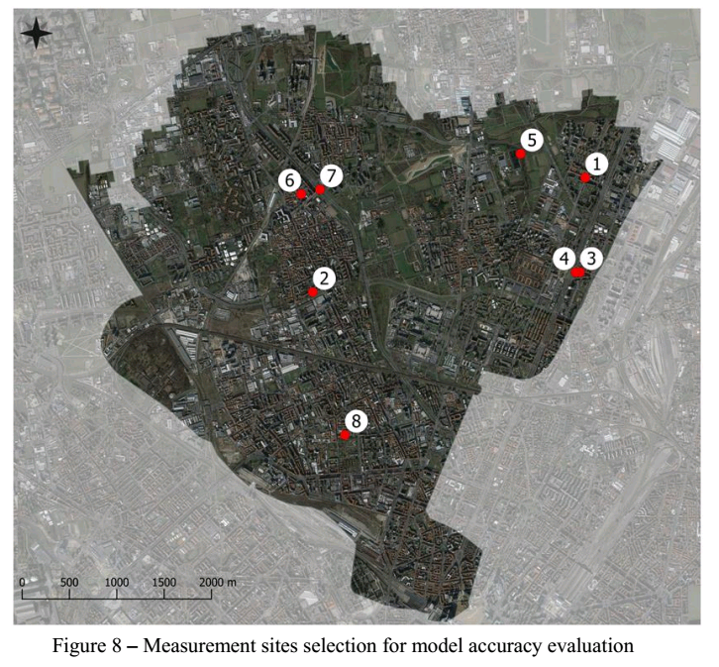

Slide 27
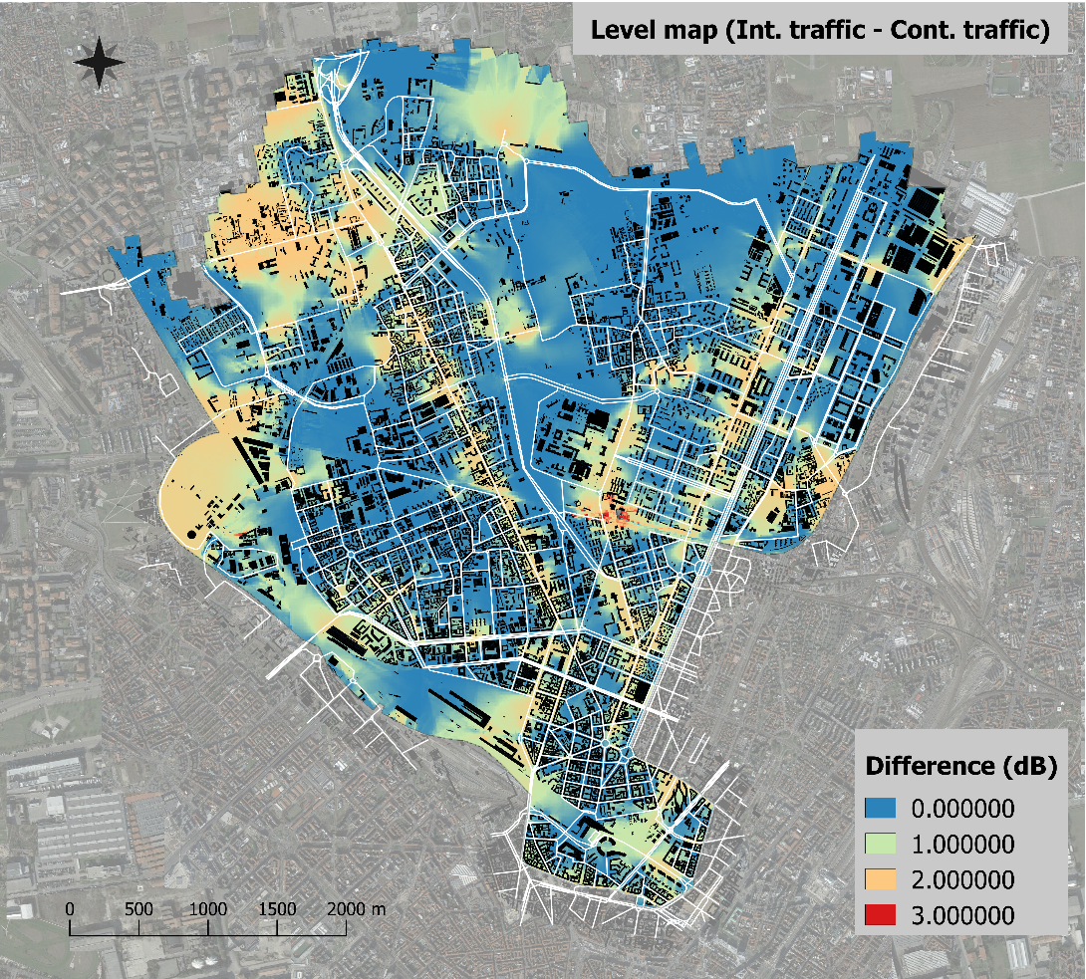
MAP OF NOISE LEVELS DIFFERENCES BETWEEN INTERRUPTED TRAFFIC AND CONTINUOUS TRAFFIC SCENARIOS

Slide 28
Final remarks
The results and the analysis done in this project action will support the decision making process regarding the updating procedure for real time map and will help to define corrective actions in order to improve the pilot area digital model accuracy.

Slide 29
THANKS FOR THE ATTENTION

